Slide 1
Homework 9 (discussion)
Redo Exercise 1 but now using the ADT data on the 15th of January, 2018.
Add in the Taiwan coastline into the figures.
Compare the Kuroshio speed in winter and summer, based on the results obtained from this homework (2018/1/15 in winter) and from Exercise 1 (2018/8/13 in summer)
Is the Kuroshio faster in winter or in summer? Show and describe your proof.

Slide 2
Homework 9 (discussion)
Redo Exercise 1 but now using the SLA data on the 15th of January, 2018.
Add in the Taiwan coastline into the figures.
Compare the eddy-current speed in winter and summer, based on the results obtained from this homework (2018/1/15 in winter) and from Exercise 1 (2018/8/13 in summer)
Are the eddy currents faster in winter or in summer, in the regions east of Taiwan? Show and describe your proof.

Slide 3
Kuroshio | fast | slow
Summer (2018/8/15) | 8 | 0
Winter (2018/1/13) | 0 | 8
Eddies east of Taiwan | fast | slow
Summer (2018/8/15) | 8 | 0
Winter (2018/1/13) | 0 | 8

Slide 4
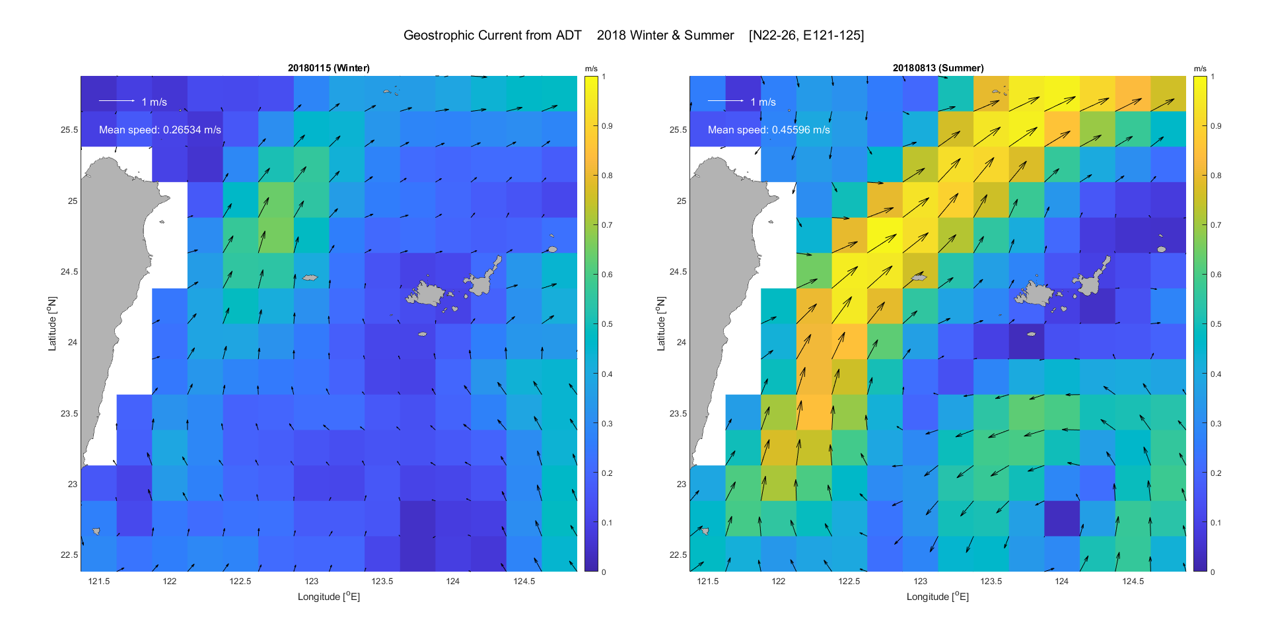
Kuroshio

Slide 5
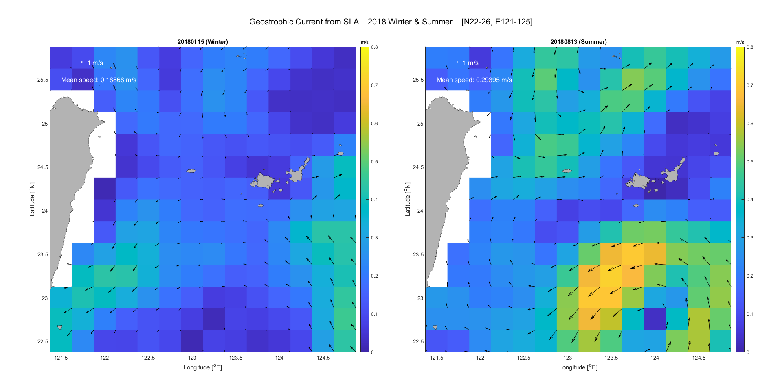
Eddies

Slide 6
Hydrographic data
XBT, CTD, Argo floats
Profiles of temperature, salinity and pressure

Slide 7
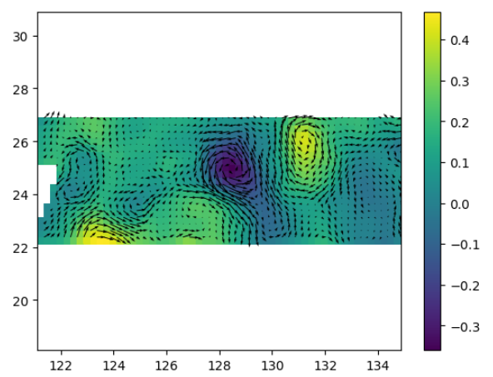
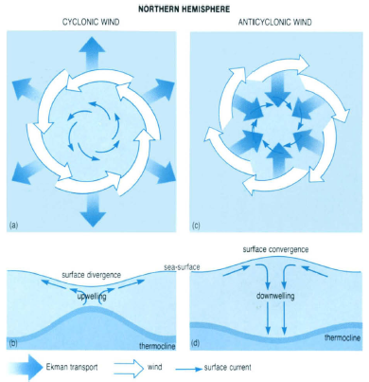
The goal of today
Preliminary study the vertical structure of eddies using hydrographic data.

Slide 8
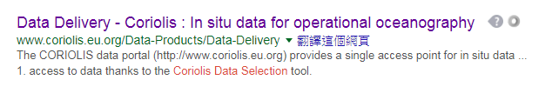
Data of today
Google Keywords: coriolis data selection

Slide 9
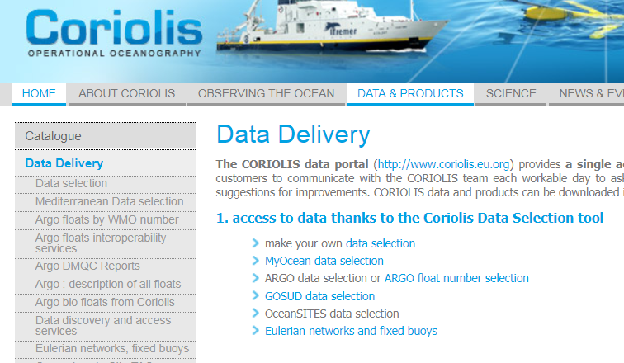
Website of Coriolis data center

Slide 10
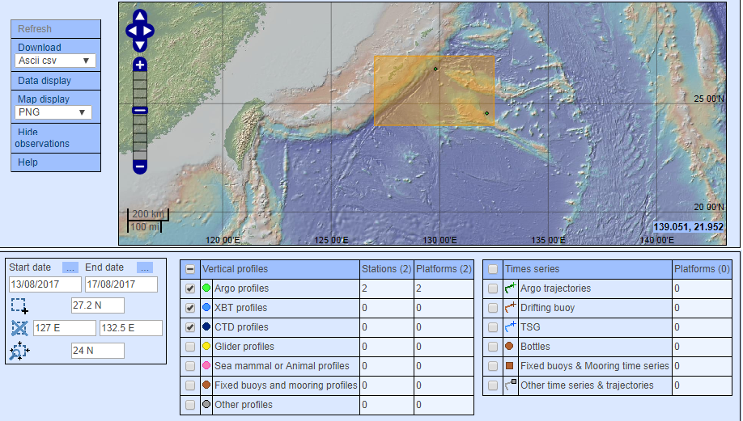
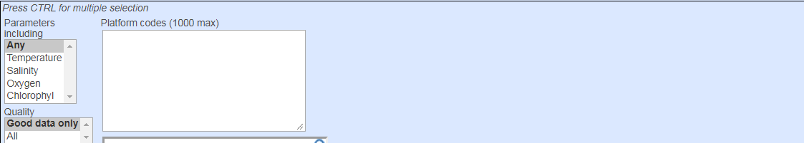
Website of Coriolis data center (Data Selection)

Slide 11
Hydrographic data (Discussion)
Anything that you know about the hydrographic data

Slide 12
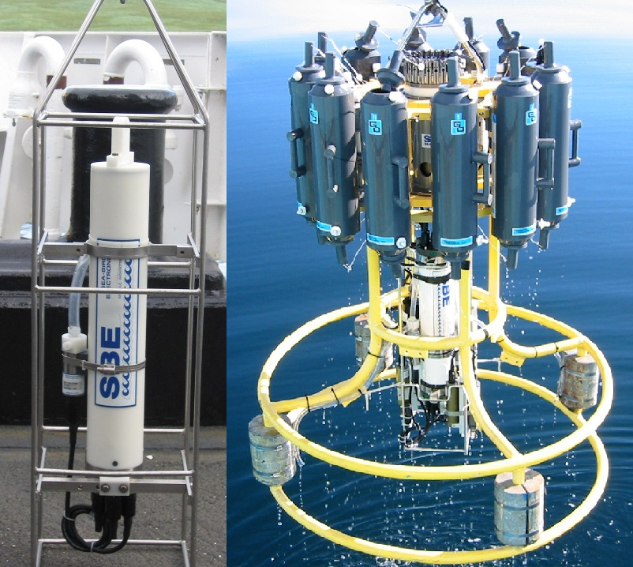
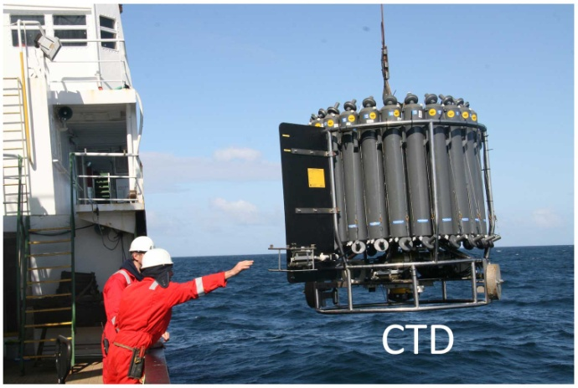
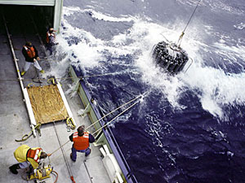
CTD Devices (REVIEW)
Temperature (T), Salinity (S), Depth (D), measure chemical or biological parameters, such as dissolved oxygen (溶解氧) and chlorophyll fluorescence (葉綠素螢光)
Calculate density:
Geostrophic Currents

Slide 13
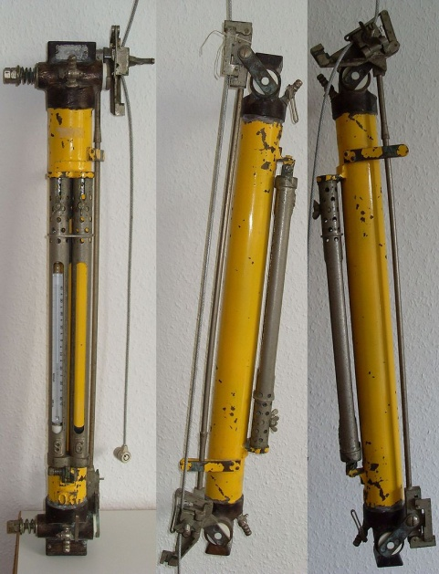
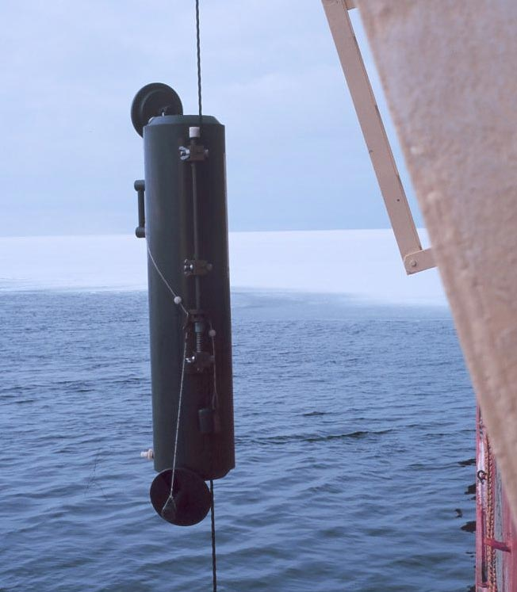
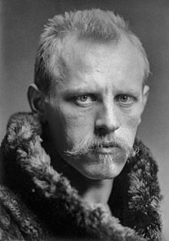
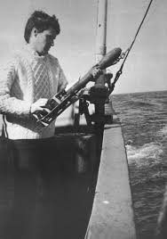
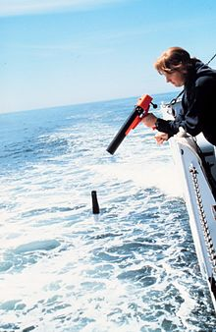
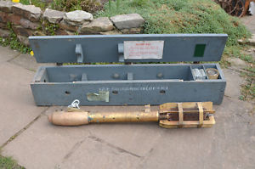
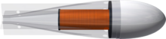
Shale Jack Niskin
[1926~1988]
Niskin bottle [1966]
Fridtjof Nansen
[1861~1930]
Mechanical Bathythermograph (MBT), expendable (拋棄式) bathythermograph (XBT)

Slide 14
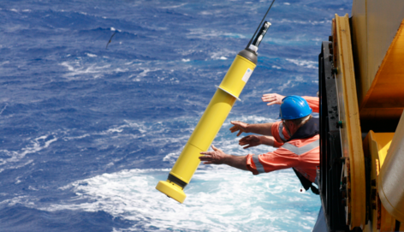
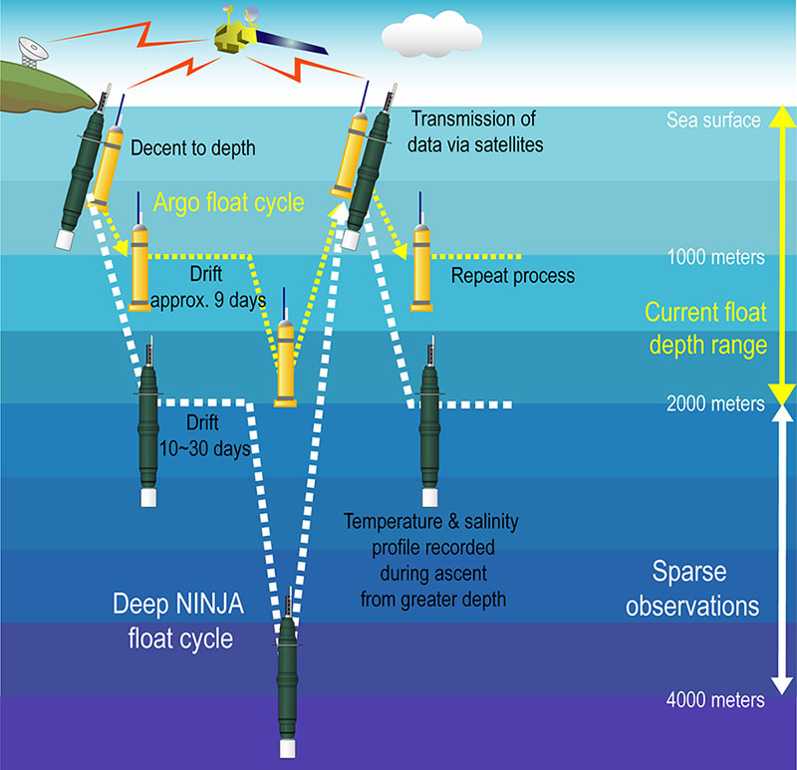
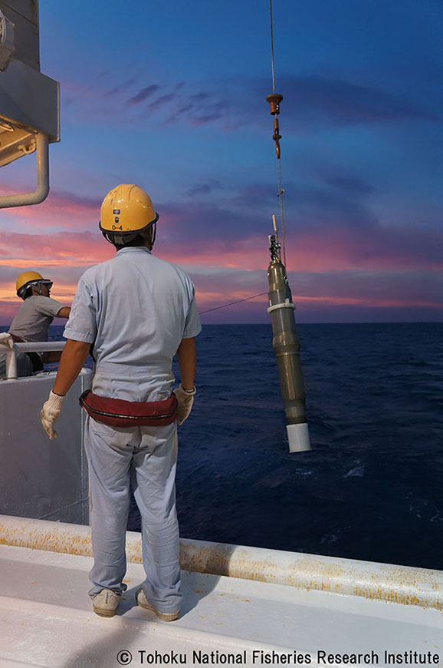
ARGO
Similar to CTD, but AUTO:
Temperature (T), Salinity (S), Depth (D)
Deep Ninja

Slide 15
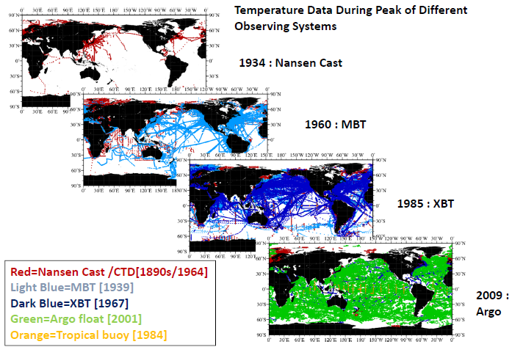
A review of global ocean temperature observations: Implications for ocean heat content estimates and climate change [Abraham et al., 2013]

Slide 16
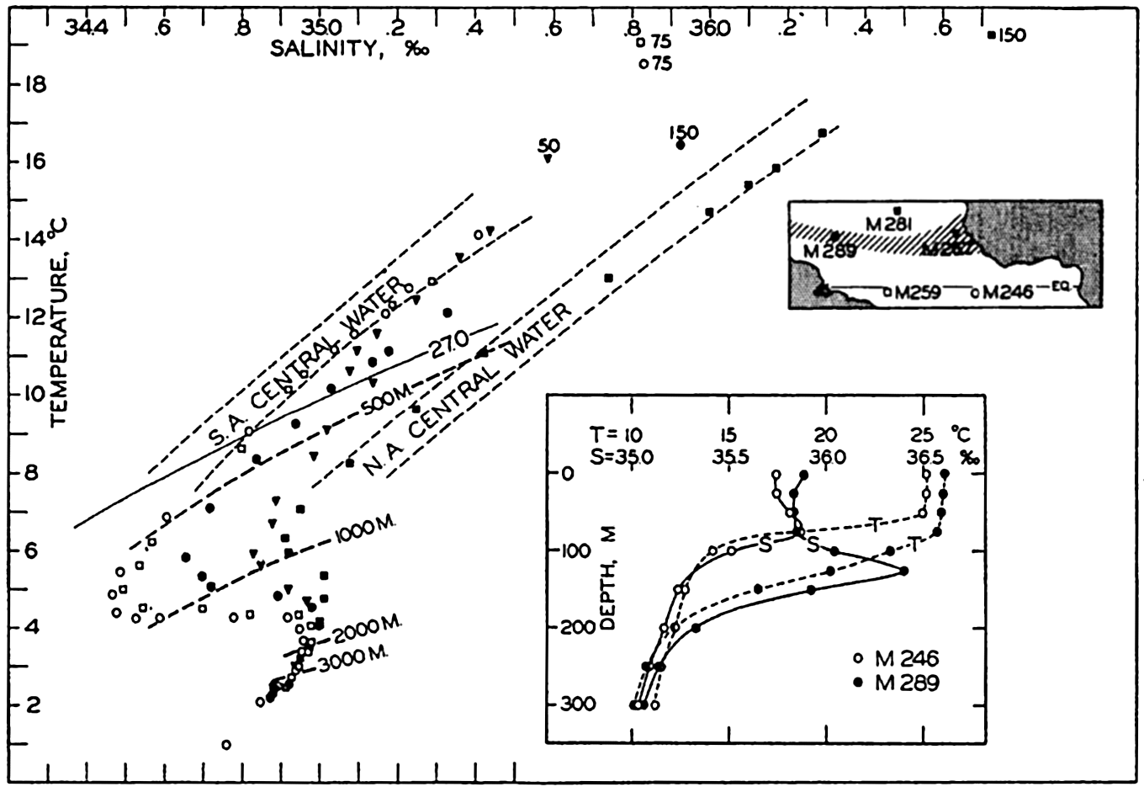
Temperature-Salinity (TS) Diagrams (REVIEW)

Slide 17
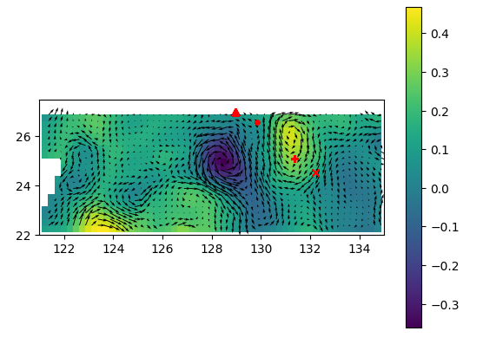
The goal of today
Study the vertical structure of eddies using hydrographic data.

Slide 18
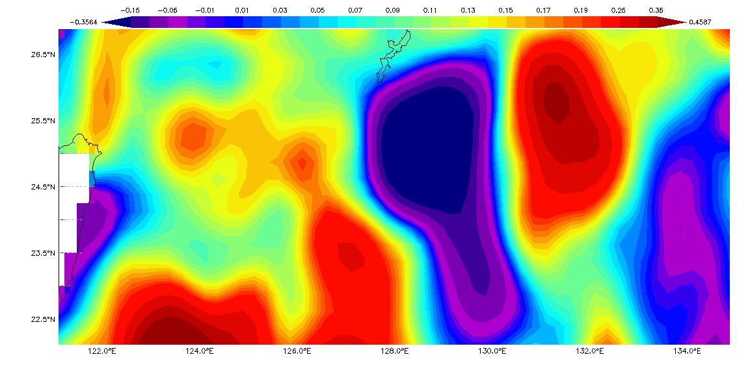
10th August

Slide 19
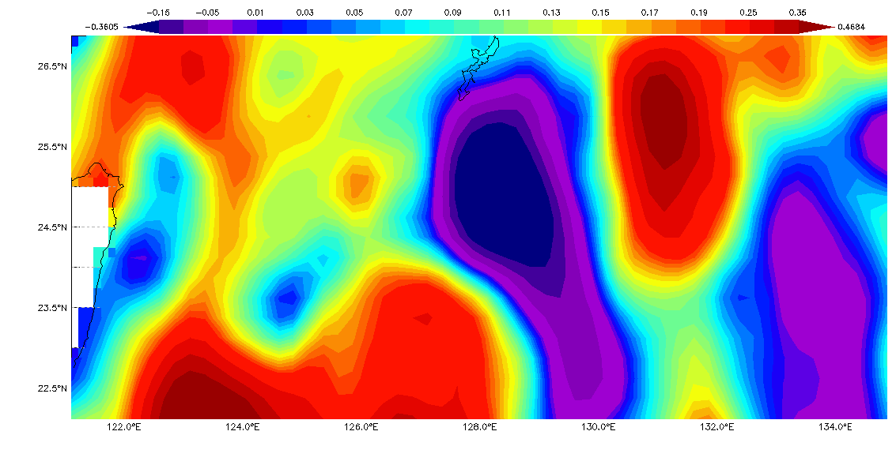
15th August

Slide 20
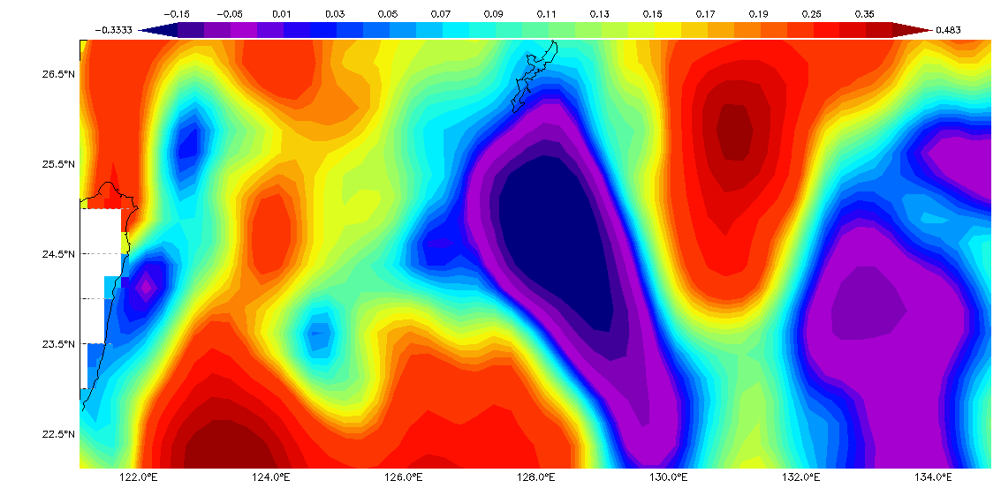
20th August

Slide 21
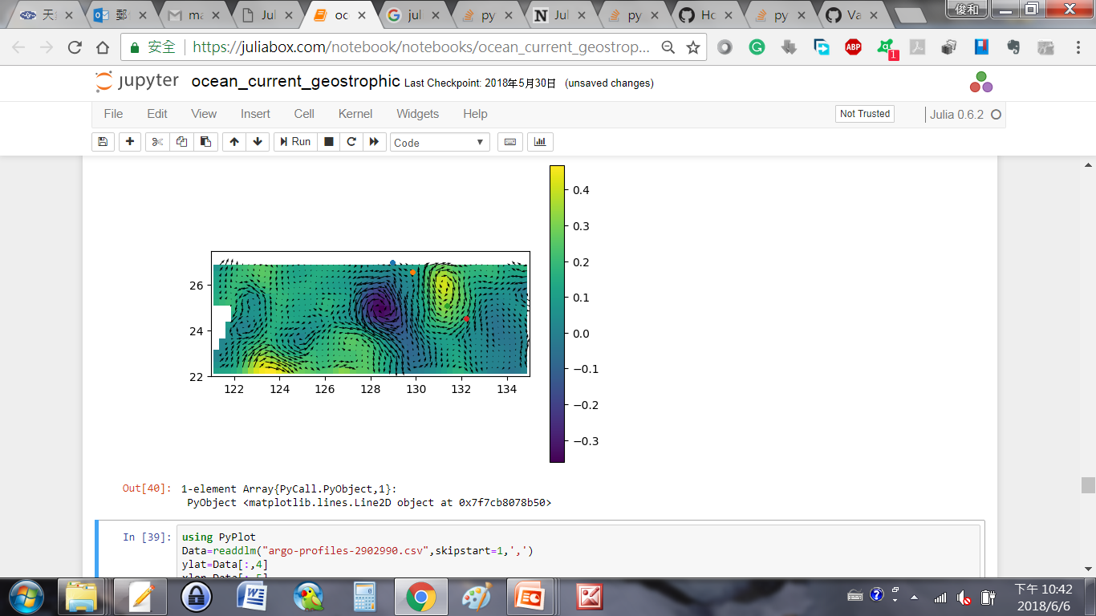
Confirm the locations of Argo floats relative to eddy center
High

Slide 22
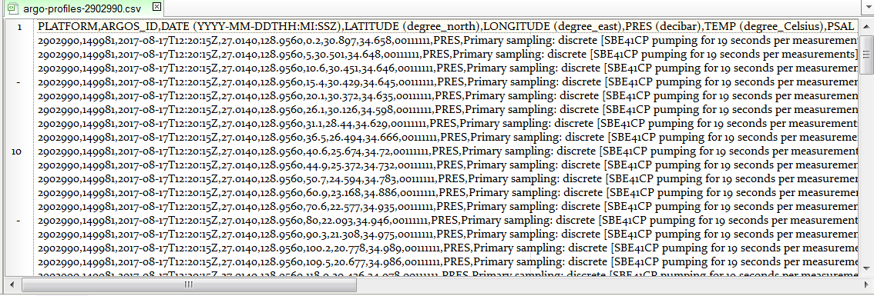
Viewing data

Slide 23
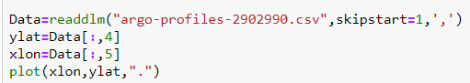
Read data and skip heading lines
filename='argo-profiles-2902990.csv';
fid = fopen(filename, 'r');
Data = textscan(fid, '%f %f %s %f %f %f %f %f %f %s %s %f %f', 'headerLines', 1,'Delimiter',',');
fclose(fid);
xlon=Data{:,5};
ylat=Data{:,4};
6

Slide 24
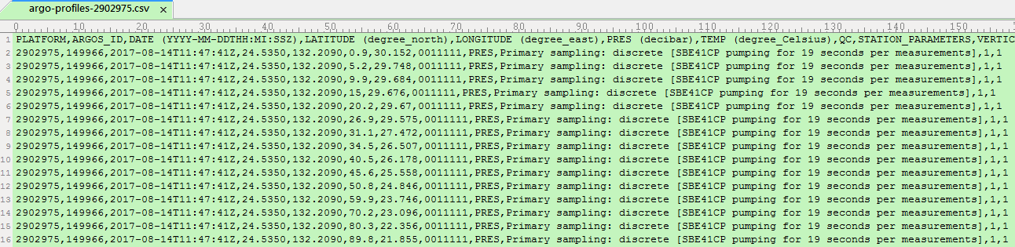
Viewing data
No salinity data for Argo 2902975
(MATLAB users)
filename='argo-profiles-2902975.csv';
fid = fopen(filename, 'r');
Data = textscan(fid, '%f %f %s %f %f %f %f %f %f %s %s %f %f', 'headerLines', 1,'Delimiter',',');
fclose(fid);
xlon=Data{:,5};
ylat=Data{:,4};
5

Slide 25
Plot Argo locations
plot(xlon,ylat, '.')

Slide 26
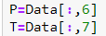
Read data of Pressure and Temperature (2902990)
P=Data{:,6};
T=Data{:,7};

Slide 27
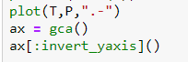
Plot temperature profiles (2902990)
plot(T,P,'.-')
set(gca,'ydir','reverse')

Slide 28
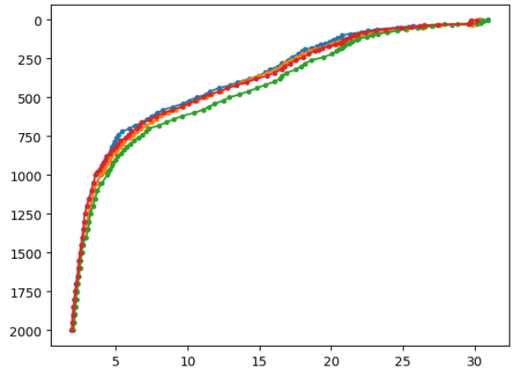
Plot temperature profiles (All Argo floats)

Slide 29
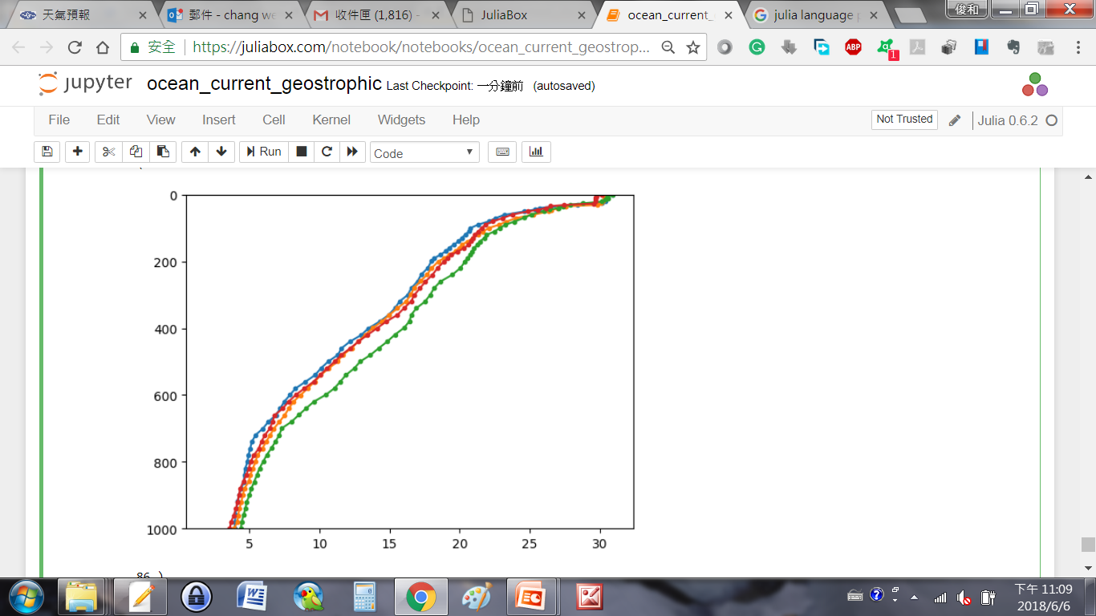
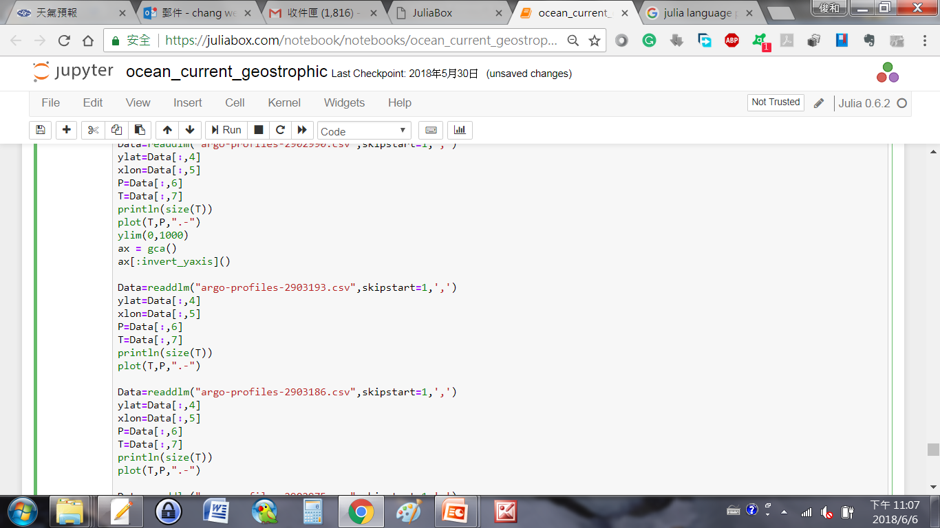
Plot temperature profiles (Zoom in)
set(gca,'ydir','reverse', 'ylim‘,[0,1000])

Slide 30
Downwelling near eddy core

Slide 31
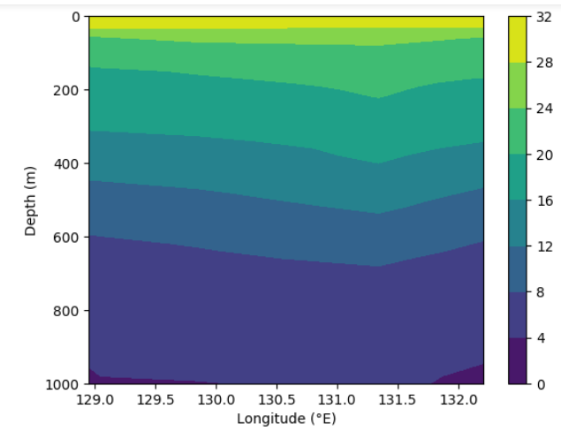
Downwelling from section

Slide 32
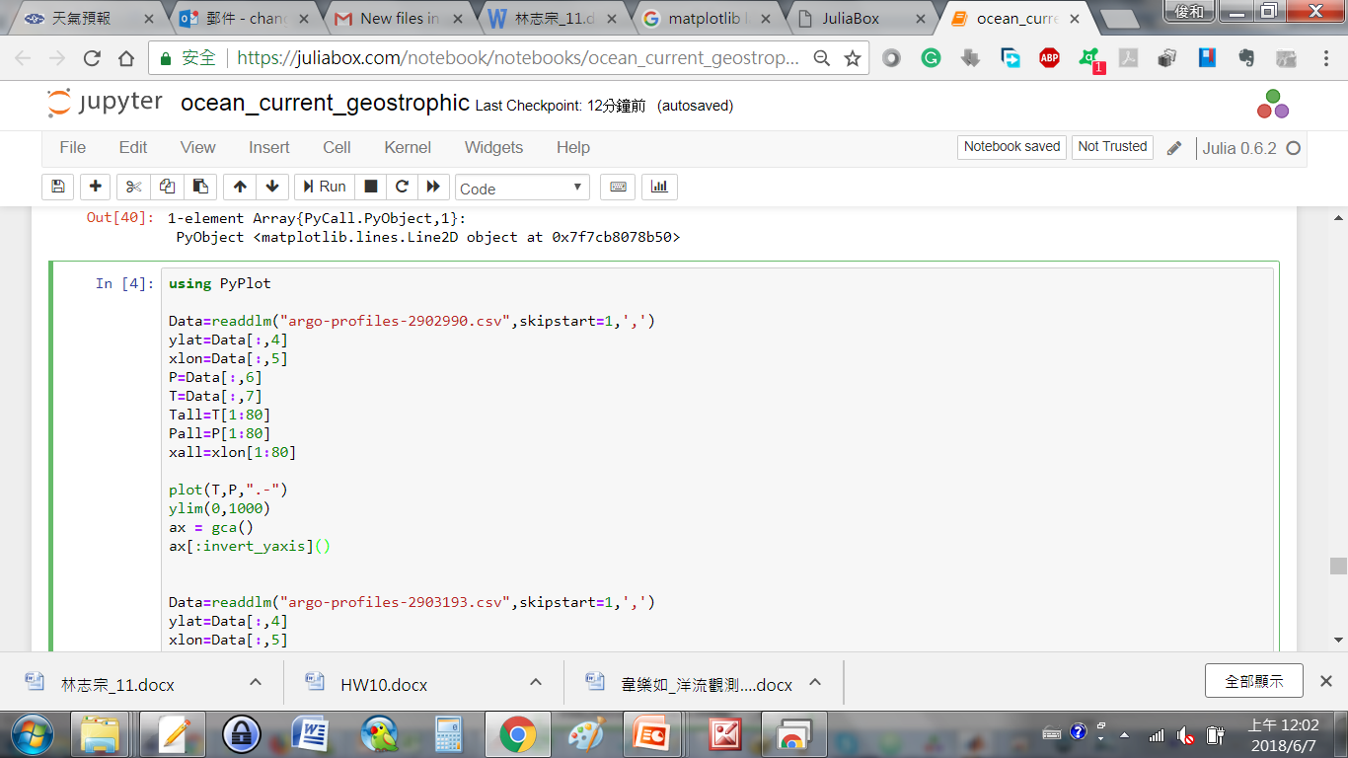
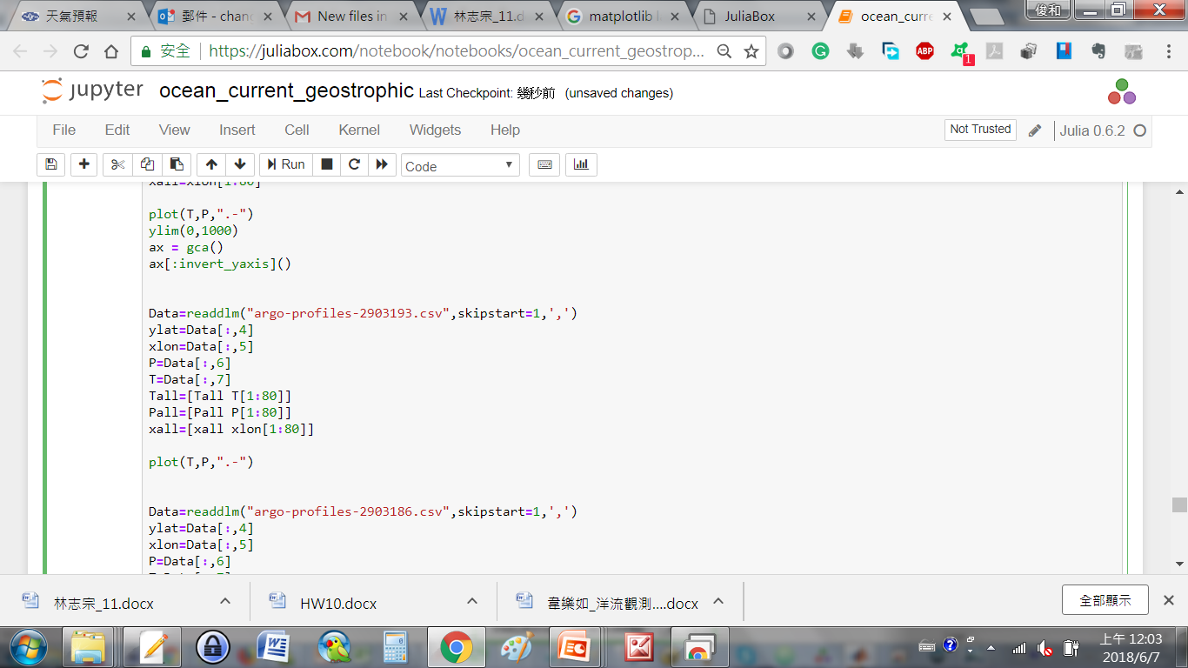
Relative codes to create section grids before plotting
xlon=Data{:,5}; P=Data{:,6}; T=Data{:,7};
Tall=T(1:80); Pall=P(1:80); xall=xlon(1:80);
……
xlon=Data{:,5}; P=Data{:,6};T=Data{:,7};
Tall=[Tall T(1:80)]; Pall=[Pall P(1:80)];
xall=[xall xlon(1:80)];

Slide 33
Plot contour fill
contourf(xall,Pall,Tall,'linecolor','none')
colorbar
set(gca,'ydir','reverse','ylim',[0 1000])

Slide 34
Homework 10 (grouping) (due date: 2020/06/09)
2~3 persons per group
Finds some Argo buoys that passed through Kuroshio and located in the South China Sea.
Compare the water properties of Kuroshio and in the South China Sea.

Slide 35
Data Review
Drifters
ADCP
Current Meters
Satellite absolute dynamic topography (ADT)
Satellite sea level anomalies (SLA)
Hydrographic data
http://www.coriolis.eu.org/Data-Products/Data-Delivery/Data-selection
https://www.nodc.noaa.gov/woce/woce_v3/wocedata_1/index.htm
https://las.aviso.altimetry.fr/las/UI.vm

Slide 36
More useful sources/links

Slide 37
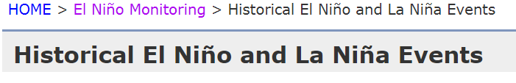
Sources for ENSO (El Niño-Southern Oscillation) Index, JMA
http://ds.data.jma.go.jp/tcc/tcc/products/elnino/ensoevents.html

Slide 38
Sources of other satellite observations
SST (Links are similar to those data of rainfall and winds. Keywords: RSS SST)
SSH
Ocean Color

Slide 39
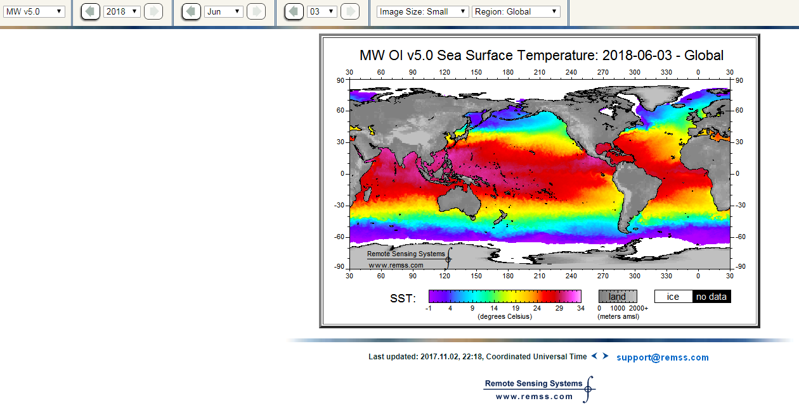
Satellite SST (Demo 5~10 mins)
http://images.remss.com/sst/sst_data_daily.html

Slide 40
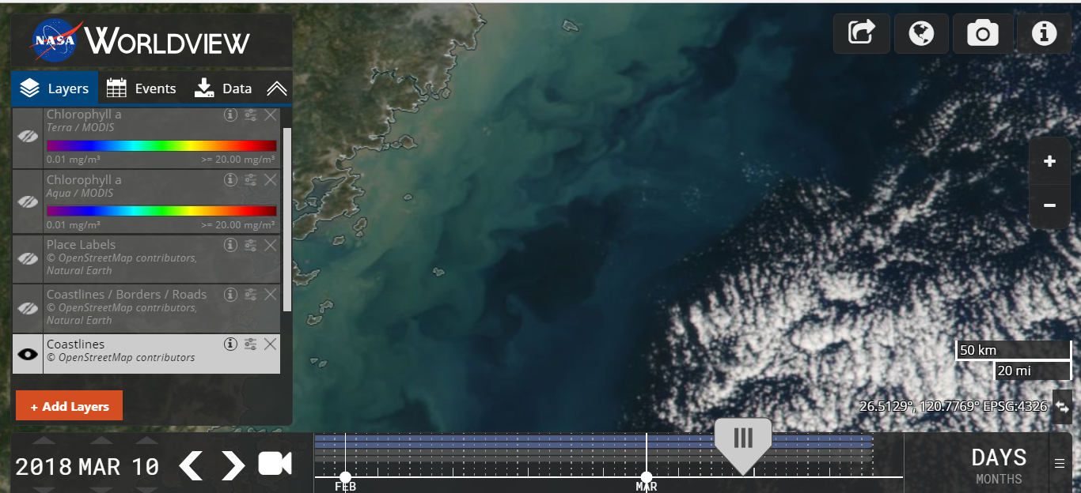
NASA worldview (Ocean color, True color)
https://worldview.earthdata.nasa.gov/
Demo 10~15 mins

